Slide 1


Machine Learning-Based Prediction of ICU Mortality
A retrospective cohort study using MIMIC-III electronic health record data to develop and validate predictive models for in-hospital mortality in adult intensive care patients
CRITICAL CARE RESEARCH
PREDICTIVE ANALYTICS

Slide 2
INTRODUCTION
The Critical Need for Mortality Prediction
Clinical Challenge
Machine Learning Advantage
Early identification of high-risk ICU patients remains essential for optimal resource allocation, timely interventions, and informed decision-making. Traditional severity scoring systems like APACHE and SOFA have limitations in capturing patient complexity and require manual calculations.
Identifies complex non-linear relationships between predictors
Provides automatic feature importance ranking
Enables real-time, scalable predictions
Continuously improves with new data
Study Objective: Develop and validate machine learning models for predicting in-hospital mortality using routinely collected EHR data from 25,324 ICU admissions.

Slide 3


METHODS
Data Source and Study Design
Database
Final Cohort
MIMIC-III v1.4: 53,423 hospital admissions from Beth Israel Deaconess Medical Center (2001-2012)
25,324 adult ICU admissions meeting inclusion criteria: age 18-85, ICU stay ≥24 hours, complete data
Outcome
In-hospital mortality: 2,497 deaths (9.86%) vs 22,827 survivors (90.14%)
Data integration involved joining 7 MIMIC-III tables including patient demographics, ICU stays, diagnoses, procedures, and outcomes. Rigorous data leakage prevention excluded post-admission variables.

Slide 4
Feature Engineering Strategy
12 Predictor Variables
Comorbidity Detection
Demographics
Binary flags created using ICD-9 diagnosis code pattern matching on standardized clinical terminology:
Age, gender, ethnicity (5 groups)
Condition
Matching Keywords
Comorbidities
Diabetes
"diabetes"
Diabetes, hypertension, CKD, CHF, COPD, cancer
Hypertension
"hypertension", "high blood pressure"
Clinical Features
CKD
"chronic kidney", "renal failure"
Diagnosis group (12 categories), respiratory procedures, comorbidity count
CHF
"heart failure", "congestive"
COPD
"copd", "emphysema", "chronic bronchitis"
Cancer
"malignan", "cancer", "carcinoma", "neoplasm"

Slide 5
MACHINE LEARNING APPROACH
Three Complementary Algorithms
Random Forest
XGBoost
Logistic Regression
500 trees, max depth 10
200 estimators, learning rate 0.1
Standardized features, balanced weights
Ensemble method robust to overfitting
State-of-the-art gradient boosting
Scale_pos_weight: 9.14 for imbalance
Interpretable linear coefficients
Handles non-linear relationships
Z-score normalized features
Balanced class weights
Early stopping to prevent overfitting
Baseline comparison model
Provides feature importance
Maximum transparency
Excellent predictive performance
Training Strategy: 80/20 train-test split with stratified sampling to preserve mortality rate distribution. Class imbalance addressed through inverse frequency weighting.

Slide 6


RESULTS
Excellent Discriminatory Performance
0.84
0.84
0.83
Random Forest AUC
XGBoost AUC
Logistic Regression AUC
Best overall balance: 77.5% accuracy, 75.2% sensitivity
Highest sensitivity: 81.0% correctly identified deaths
Competitive performance with maximum interpretability
Clinical Interpretation: An AUC of 0.84 means these models correctly rank a randomly selected deceased patient as higher risk than a randomly selected survivor 84% of the time—substantially better than traditional scoring systems.

Slide 7
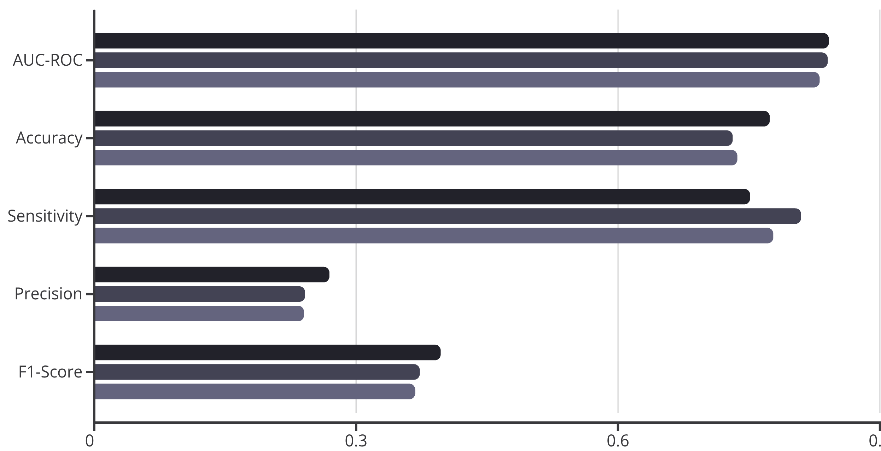
Model Performance Metrics Comparison
Random Forest
XGBoost
Logistic Regression
Random Forest: Best Balance
XGBoost: Maximum Sensitivity
Correctly identified 375 of 499 deaths (75.2%) while maintaining 77.7% specificity. Optimal for balanced decision-making.
Missed only 95 deaths (19.0% false negative rate)—ideal for screening high-risk patients when missing deaths is costly.

Slide 8
FEATURE IMPORTANCE
Respiratory Failure Dominates Mortality Risk
Respiratory Procedures
40-98% importance across models
Mechanical ventilation, intubation, and tracheostomy emerged as the overwhelming predictor of mortality, reflecting severe respiratory failure and multi-organ dysfunction.
Chronic Kidney Disease
11-50% importance
CKD complicates ICU recovery through fluid overload, electrolyte imbalances, and uremic complications.
Patient Age
1-45% importance
Non-linear relationship with mortality reflecting decreased physiological reserve in older adults.
Active Malignancy
2-20% importance
Cancer diagnosis associated with advanced disease, immunosuppression, and treatment complications.
Comorbidity Burden
1-10% importance
Cumulative effect of multiple chronic conditions capturing overall patient frailty.

Slide 9
CLINICAL IMPLICATIONS
Translating Predictions into Practice
Risk Stratification at Admission
Clinical Decision Support
Quality Improvement
Real-time mortality predictions guide treatment intensity, facilitate informed family discussions regarding prognosis, and support advance care planning conversations.
Benchmark ICU performance using risk-adjusted mortality, identify patients for protocol-driven interventions, and monitor temporal trends in outcomes.
Identify high-risk patients immediately upon ICU admission to enable early mobilization of critical care resources and support triage decisions during resource scarcity.
Respiratory Management Focus
Multidisciplinary Coordination
Emphasize respiratory failure prevention, implement early intervention for at-risk patients, and consider non-invasive ventilation strategies to avoid intubation.
CKD patients require nephrology involvement, age-adjusted protocols for geriatric patients, and palliative care consultation for cancer patients.

Slide 10

CONCLUSIONS
Machine Learning Enhances ICU Mortality Prediction
Excellent Performance
All three models achieved AUC >0.83, demonstrating superior discriminatory ability compared to traditional scoring systems while requiring fewer physiological measurements.
Random Forest Optimal
Best balance with 77.5% accuracy and 75.2% sensitivity, correctly identifying 3 out of 4 deaths at ICU admission using routine EHR data.
"These models offer potential for real-time implementation as clinical decision support tools to identify high-risk patients, guide resource allocation, and improve ICU outcomes."
Respiratory Focus
Need for invasive respiratory support emerged as the dominant predictor (40-98% importance), highlighting critical pathway to mortality.
Study Cohort: 25,324 ICU admissions | Mortality Rate: 9.86% | Code Available: Complete methodology documented and reproducible
Next Steps
01
External validation on independent datasets (eICU, MIMIC-IV)
02
Prospective clinical trial of ML-guided decision support
03
Incorporate time-series physiological data and clinical notes
04
Implement explainable AI with SHAP values for transparency

